Slide 1
HISTORICAL THINKING ASSIGNMENT

Slide 2
FOUR KEY HISTORICAL THINKING SKILLS
SIGNIFICANCE – explaining why something is important
PERSPECTIVE – identifying events from the viewpoint of people who lived through the times

Slide 3
FOUR KEY HISTORICAL THINKING SKILLS
CAUSE AND CONSEQUENCE – understanding the relationship between events and their results
CONTINUITY AND CHANGE – understanding that certain things (attitudes, processes, actions) change over time and certain things remain the same

Slide 4
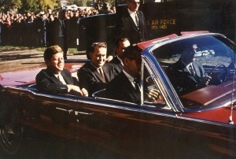
CONTINUITY AND CHANGE

Slide 5
THE KENNEDY ASSASSINATION
On November 22, 1963, John F. Kennedy was assassinated in Dallas, Texas. The country went into mourning as a result, but it still had to move on. Vice-president Lyndon Johnson was soon sworn in as the new president. He continued many of Kennedy’s policies until he was elected himself in the 1964 election. While Johnson was able to implement new policies and expand the war into Vietnam, he made sure that the transition was a slow one. The United States would not fundamentally change as a country despite the loss of their president.

Slide 6
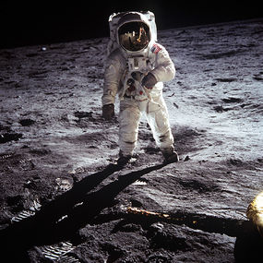
CAUSE AND CONSEQUENCE

Slide 7
FIRST MOON LANDING
As the Cold War “heated up”, the rivalry between the Soviet Union and the United States expanded into a variety of areas including military strength, sports and scientific excellence. The Soviets launched the first satellites, the first animal into space, the first man into space and the first woman into space. It appeared that the United States was lagging behind. The real prize was a moon landing so in response to a “space race”, the United States accelerated their space program. It culminated on the night of July 20, 1969 with the landing of the Apollo 11 space craft on the moon. Neil Armstrong became the 1st man to step on the moon.

Slide 8
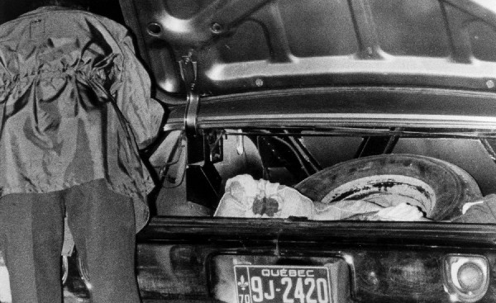
HISTORICAL PERSPECTIVE

Slide 9
FLQ CRISIS, DEATH OF PIERRE LAPORTE
In 1970, as part of the October Crisis, Pierre Laporte was killed by FLQ terrorists. While many Quebecers initially supported the goals of independence through radical means, they were disgusted by a deliberate murder. They condemned the actions they once supported. In time, they turned to a political solution to Quebec separation, a move that helped split the province into two clear factions; those in favour of independence and those loyal to a united Canada.

Slide 10
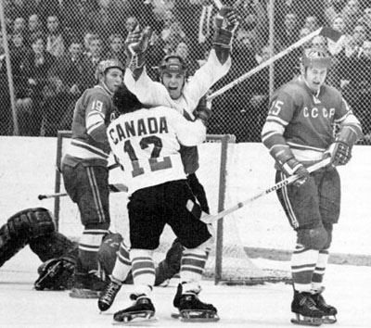
SIGNIFICANCE

Slide 11
SUMMIT SERIES 1972
The Summit Series of 1972 pitted Canadian professional hockey players against players from the Soviet Union for the first time. The Soviets had come to dominate international hockey at world championships and the Olympics. At the time, professional players were not allowed in these competitions. The series was meant to be a competition between “their best” and “our best” and it was largely felt that Canadian professionals would have little difficulty against the “amateur” Soviets. This was not the case. After 7 games, the series was tied at 3 wins apiece and a tie. The series came down to the final 36 seconds of game 8 when Paul Henderson scored, giving Canada a 4-3-1 record. Suddenly it had became more than a hockey series, it became a battle of political and cultural systems. While it gave Canada the right to claim hockey supremacy, it also helped change our approach to the game. It showed Canadians that skill, style and team play could be very effective. It also showed that international hockey was catching up to Canadian hockey and that the sport would not be easily dominated again.

